Slide 1

April 28-29, 2026
QTD
EMERGENCY DEPARTMENTs

Slide 2
Quarterly Triage Days
Preparedness opportunity
  Never know when or where for MCIs
  How to use SALT, Ribbons, & Radios
  OPPORTUNITY FOR EMS and EDs TO WORK TOGETHER!

Slide 3
Quarterly Triage Days
Collaboration with EMS, Emergency Departments, GDAHA, GMVEMSC, RPAB, et al
24 hours once per quarter
For all hospitals or EDs and EMS agencies

Slide 4
April 29-30, 2026 QTD:
“Ribbons & Radios”
  Perform SALT triage on EVERY patient – EMS & ED
  Place Triage Ribbon on EVERY patient – EMS & ED
  MCI radio report on every EMS transport
  This month: no tags, no EMTrack

Slide 5
SALT for QTD
Assign a realistic SALT Category for EVERY EMS and ED patient:

Slide 6
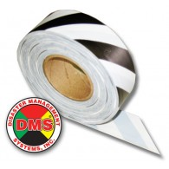
Salt Triage Categories: ID-MED
Immediate
  Can’t follow commands, in respiratory distress, uncontrolled arterial bleeding, or wrist pulse not palpable
Delayed – Serious illness or injury
Minimal – Minor illness or injury
Expectant – not applicable for QTD
Dead – hopefully not applicable for QTD
    (Ribbon/Tag zebra-striped)
Notes:
The answers to these questions will allow you to place the patient in one of the 5 categories shown here. Each category is given a color code so that they can be recognized quickly.

Slide 7
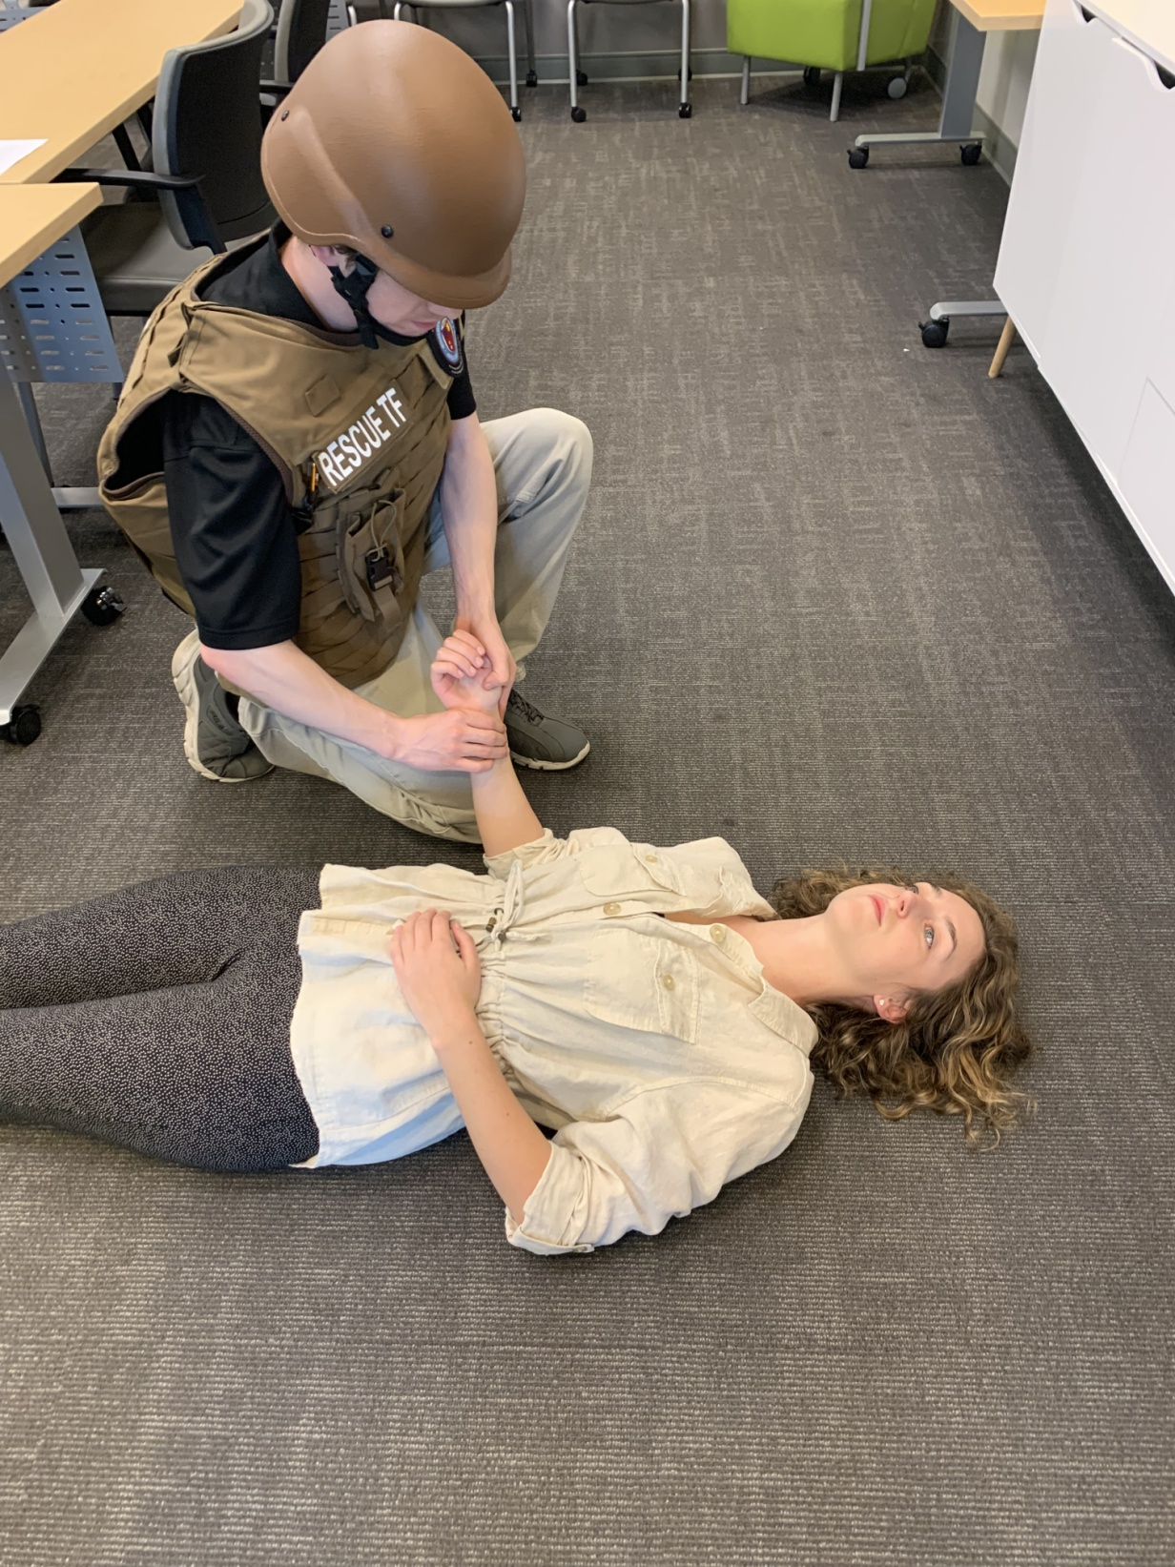
SALT KEY QUESTION Mnemonics:
C-R-A-P and GooD/Bad
7-8 seconds:
C – Commands /Purposeful movements?
R – Respiratory Distress?
A – Uncontrolled (Arterial) bleeding?
P – Peripheral Pulse Present?
If patient is clinically “bad” to one or more assessment questions: patient is Red (or Gray)
All others are Yellow or Green

Slide 8
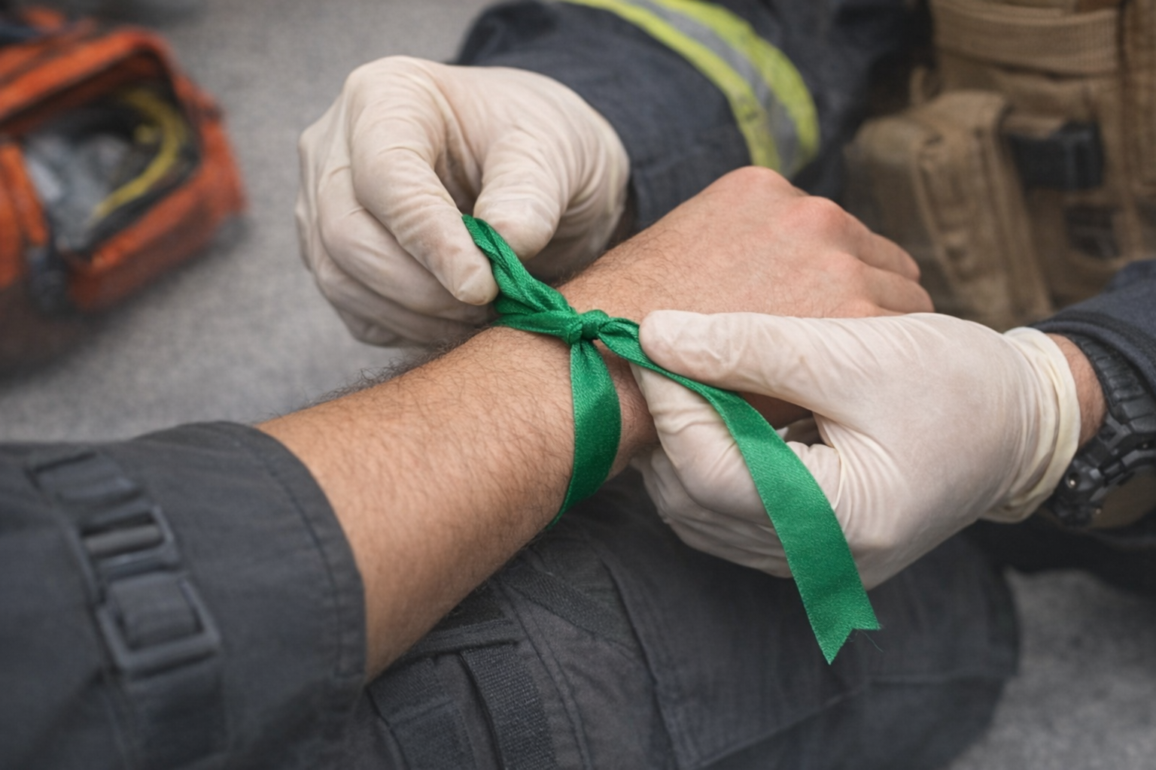
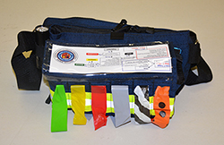
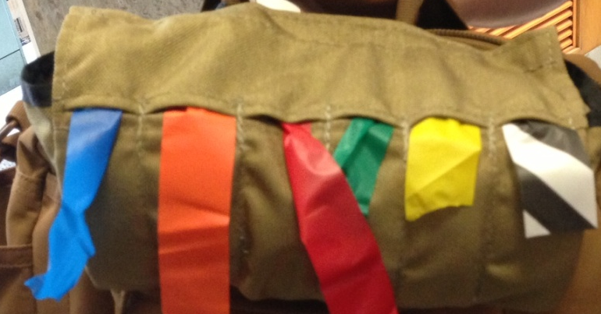
PUT a Ribbon on every EMS and every ED patient!
Use Triage Ribbon color for the category you assigned
  Right wrist for both Ribbon and Tag

Slide 9
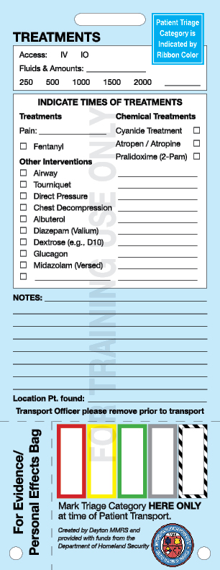
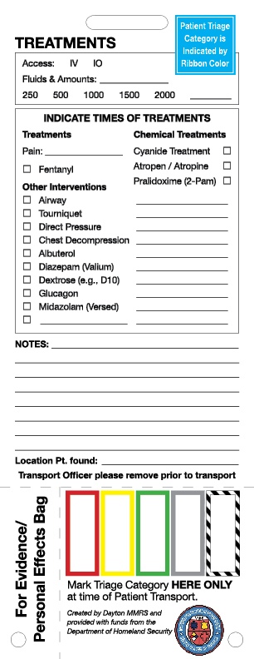
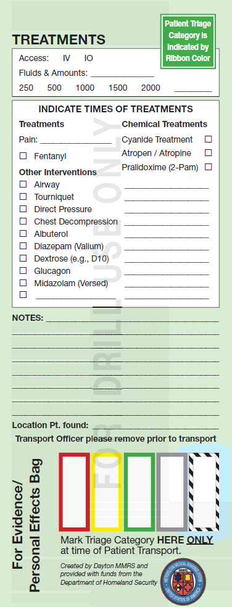
NO Tags for April 2026 QTD

Slide 10
Expectations
Expect a Ribbon on EVERY EMS and ED patient during this QTD
  (and during a real-world MCI!)
Expect a radio call on the MCI Talk Group on EVERY EMS transport during QTDs

Slide 11
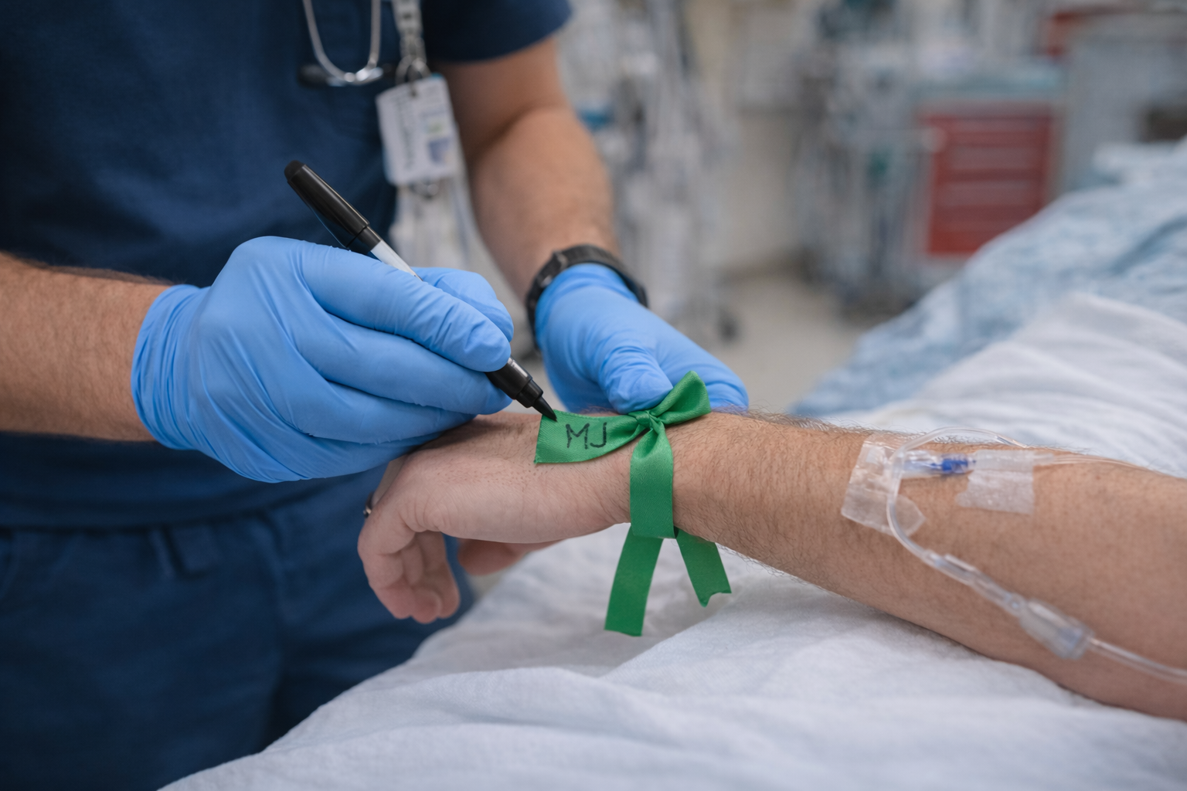
ED Personnel
ED staff must place a ribbon on every patient!
  ED staff put your initials on each ribbon you apply
  This allows us to differentiate ribbons put on by the ED from ribbons placed by EMS
If EMS ribboned the patient, ED does NOT need to add one
When each patient leaves ED (discharged or admitted), collect and save the ribbon

Slide 12
HSR3 MCI-MARCS Radio TG
During an event, EDs turn on MCI TG
  Monitor MCI radio following any MCI notification via Regional Hospital Notification System (RHNS)
During QTDs, EDs must turn on and monitor the MCI TG
If the ED did not answer the MCI radio, EMS will offer to assist with the radio on arrival

Slide 13
HSR3 MCI-MARCS Radio TG
No alerts on MCI TGs!
Hospitals monitor MCI Radio during MCI and QTD, but…
  EDs are noisy!
  EMS must clearly identify which ED is being called
  EMS must carefully confirm which ED answered
  EDs must listen to be sure the call on the MCI TG is for them
  EDs must clearly state which ED is answering

Slide 14
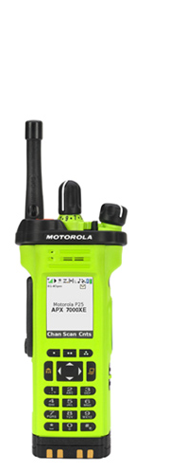
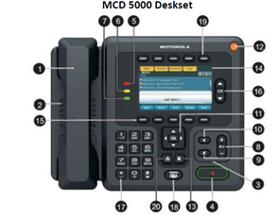
MCI-style reports on QTDs
Expect EMS to make BRIEF, MCI-style reports to the ED on the MCI Talk Group for every patient during 24 HOURS of QTD
  Example: “Wayne Hospital, this is Greenville Medic 591 enroute with one Yellow, possible fractured ankle.”
MCI Reports should be DIFFERENT!
  When there are 40 patients, you do NOT want EMS to make a full report on each!
  MCI calls: No vital signs, no EKG findings, no medical hx
  Short, sweet, to the point!
If EMS provides a report that is too extensive, give courteous feedback
If an ED has trouble responding over the MCI radio, please offer to help ED staff upon your arrival. Disaster preparedness is collaborative!

Slide 15
EMS Coordinators
At conclusion of the 24-hour QTD, count ribbons with and without initials for your ED
Email tallies of three numbers based on counts of collected ribbons to GDAHA and MMRS:
  Total number of ED patients during the 24 hours
  Number of ribbons placed by EMS crews
  Number of ribbons placed by ED staff

Slide 16
100%!!
The goal for this QTD is participation by EVERY EMS and ED in the region!
When EMS arrives at EDs, the patient should already have a ribbon in place
Everyone should see a ribbon on EVERY ED patient
LET’S ALL WORK TOGETHER!

